Slide 1

Visvesvaraya National Institute of Technology, Nagpur
Electronics and Communication Engineering Department
Executive M.Tech. in Applied AI & Communication
Cohort- 3A & 3B, Sem-3
Eval. 1 (05/04/2026)
NATURAL LANGUAGE PROCESSING
LABORATORY (ECL-545)
Automated Analysis of Meter Testing Remarks
Presented by-
Group No.-09
Ishita Sood (MT24AAI165)
Shubham Saxena (MT24AAC034)
Under the supervision of
Prof. Saugata Sinha
VNIT Nagpur

Slide 2
Contents
Problem Statement & Dataset
Methodology and Algorithms
Work Done till now
Results Obtained till now
Pending Work to do

Slide 3
Problem Statement & Dataset
Output Labels (Action Categories)
We mapped remarks into structured classes:
TESTED_OK → No further action required
INSTALLATION_REPLACEMENT → Meter replacement required
CEG_ANALYSIS → Seal / technical investigation cases
ZONE_RECTIFICATION → Network / voltage issues
SITE_NOT_READY → Access / safety issues
ADMIN_CLOSURE → Administrative closure cases
CUSTOMER_DEPENDENT → Customer unavailable / refusal
VISIT_REQUIRED → Revisit or rescheduling required
Key Insight:
Dataset converts:
field-level textual remarks → structured operational decisions.
Problem Statement:
In utility meter testing operations, large volumes of unstructured textual remarks are generated daily.
These remarks are written manually by field engineers and are:
Inconsistent in language
Unstructured in format
Difficult to analyze at scale
This leads to delays and errors in assigning correct action categories and departments
Objective of the Project:
To develop an NLP-based classification model that:
Automatically analyzes meter testing remarks
Predicts correct Action Target / Category
Enables faster, consistent decision-making in utility workflows
Train-Test Dataset
Dataset Description:
Source: Real-time utility meter testing records (1-year data for Training and 3 Months data for Testing)
Total Dataset Size: ~15,000 manually entered remarks
Original Dataset Structure
221 total columns available in raw dataset (150+ MB in size)
Selected Relevant Columns (Final Use Case)
We filtered and used only:
Serial Number → Reference ID
Text Remarks → Input Feature (NLP Text)
Hold Cancel Reason
Hold Cancel Remarks
Current Status → Target-related information
Meter Testing Remarks → Standard Action Categories

Slide 4
Results Obtained
[Step-1] Model Development
Key Insights:
Generated 1048 unique textual features using TF-IDF vectorization
4/1/2026

Slide 5
Pending Work To Do
4. Model Development & Optimization:
Train Logistic Regression model on TF-IDF feature vectors
Perform train-test split and evaluate model performance
Use evaluation metrics:
Accuracy
Precision
Recall
F1-Score
Improve performance using:
Improve performance using:
Hyperparameter tuning
Feature refinement (e.g., n-grams)
5. System Integration & Prediction Pipeline
Develop an end-to-end prediction system
Integrate:
Text preprocessing
TF-IDF vectorization
Trained classification model
Enable system to:
Accept user remark as input
Predict concerned department in real-time
6. Live Deployment & User Testing
Deploy model on live/new dataset of meter testing remarks
Process real-time user inputs through the trained system
Automatically classify remarks into respective departments
Enable direct routing of actions without manual intervention
Validate system performance with real-world data
4/1/2026

Slide 6
THANKS
We are open for questions.

Slide 8
Methodology and Algorithms
Problem Formulation:
The task is formulated as a Supervised Multi-Class Text Classification Problem
Map unstructured meter testing remarks → predefined department/action classes
Project Pipeline:
Text Preprocessing Techniques:
To transform raw text into a clean, standardized corpus for feature extraction. We applied standard NLP normalization to reduce noise and improve feature quality:
Case Normalization → Lowercasing for uniformity
Noise Removal → Elimination of punctuation, digits, and special characters
Stopword Removal → Removal of high-frequency non-informative tokens
Tokenization → Conversion of text into individual lexical units
Feature Engineering: TF-IDF Vectorization:
Used Term Frequency-Inverse Document Frequency for feature representation. Mathematically,
where:
TF(t,d): Term frequency in document
DF(t): Document frequency
N: Total number of documents
Model Selection: Logistic Regression:
Used Logistic Regression for classification. Estimates probability using Sigmoid Function:
Extended using Softmax Function for multi-class classification
Reason why Logistic Regression is Choosed?
Efficient for high-dimensional sparse data (TF-IDF vectors)
Performs well in linear decision boundary problems
Computationally efficient and scalable
Provides probabilistic outputs for class prediction
Model Training Strategy:
Dataset split into:
Training Set (80%)
Testing Set (20%)
Optimization using Maximum Likelihood Estimation
Model Training will be Evaluated using:
Accuracy
Precision
Recall
F1-Score
Prediction & Decision Routing:
Predicted class corresponds to:
Concerned Department
Further mapped to Actionable Workflow
Live Deployment & User Testing:
After achieving satisfactory performance during model training and testing, the system is deployed on a new/live dataset of meter testing remarks.
The trained model processes real-time user inputs and automatically classifies remarks into the appropriate department, enabling direct routing without manual intervention.
P(y) = 1 / (1 + e^(-z))
Raw Text Data
Text Preprocessing
Feature Extraction (TF-IDF)
Prediction & Descision Routing
Model Training (Logistic Regression)
TF-IDF = TF(t,d) × log(N / DF(t))
4/1/2026
Notes:
Key Advantage of TF-IDF Vectorization:
- Assigns higher weights to important domain-specific words
- Produces high-dimensional sparse feature vectors
- Reduces influence of common but less meaningful terms

Slide 9
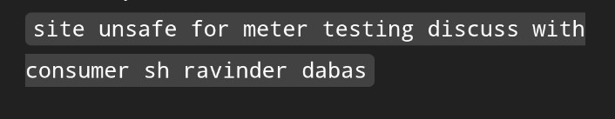
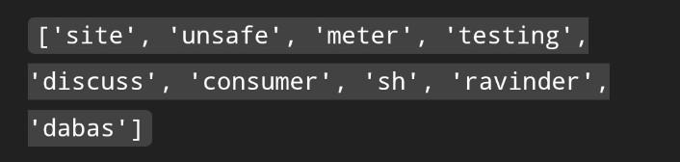
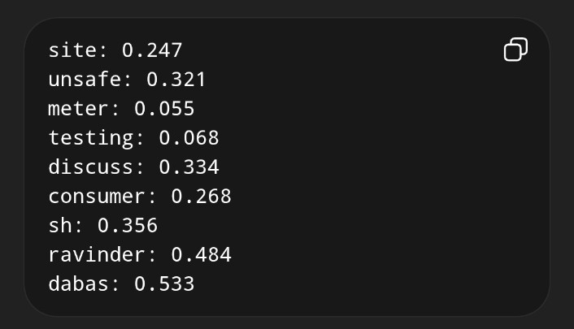
Work Done till now
STEP 1 — Cleaning + Lowercase (example)
1. Dataset Preparation:
Collected and structured meter testing remarks dataset
Defined target classes corresponding to concerned departments/actions
Ensured proper labeling for supervised learning
2. Text Preprocessing & Cleaning:
Performed multiple NLP-based cleaning steps to improve data quality:
Converted text to lowercase for uniformity
Removed punctuation, numbers, and unwanted symbols.
Eliminate noise patterns and irrelevant text.
Applied stopword removal to discard non-informative words.
Performed tokenization to split text into meaningful units.
3. Feature Engineering:
Implemented Term Frequency-Inverse Document Frequency (TF-IDF) vectorization
Transformed textual data into numerical feature vectors
Captured importance of domain-specific keywords
STEP 2 — Tokenization + Stopword Removal (example)
STEP 3 — TF-IDF Vectorization (example)
High TF + High IDF = Very Important Word
High TF + Low IDF = Common word (not useful)
4/1/2026

Slide 10
Results Obtained till now
[Step-1] Initial Data Structuring & Classification Setup
[Step-2] Text Preprocessing & Cleaning
NLP Output Label | Codes | Description | Next Concerned Department
TESTED_OK | — | No further action | None / Case Closure System
INSTALLATION_ REPLACEMENT | D255, D490 | Meter replacement required | Meter Replacement / Installation Team
CEG_ANALYSIS | D168, D320, D460 | Seal missing / suspected / technical analysis | CEG / Enforcement / Vigilance Team
ZONE_ RECTIFICATION | D395, D510, D330, D400 | Voltage / network issue | Network / Zone Maintenance Team
SITE_NOT_READY | D030, D315, D430, D440, D500, D271, D606, D603, D275, D601 | Locked / no access / unsafe | Field Operations / Meter Testing
ADMIN_CLOSURE | D120, D385, D610 | Wrong notification / work already done | Back-Office / Administrative Operations
CUSTOMER_ DEPENDENT | D560 | Consumer not available / refused | Customer Service / Call Center
VISIT_REQUIRED | D270, D360, D570, D580 | Visit not done / reschedule | Scheduling / Field Dispatch Team
SR_NO | TEXT_REMARKS | ACTION_CATEGORY | HOLD_CANCEL_REASON
710 | Meter already replaced New meter No -79039984 | Meter already replaced New meter No | D270
1860 | Meter display showing temper and MDI 347.98 kw suspected referred to enforcement and discuss with consumer sh Hament on phone no 9873511623 | Meter display showing temper and MDI kw suspected referred to enforcement and discuss with consumer sh Hament on phone no | D320
2036 | meter already removed at site date on 5/11/25 consumer name is Suresh mobile number is 9891816286 | meter already removed at site date on consumer name is Suresh mobile number is | D360
2582 | 3 time visit but no person at site no response on call -9811304502 | time visit but no person at site no response on call | D385
3375 | 2 time visit but premises found locked no response on call -9899460445 | time visit but premises found locked no response on call | D430
8421 | EL LED found Glowing even on External Load (2 KW), hence meter is defective and therefore same needs to be replaced under defective category Contacted Person- Jagbir Singh (9891593144) | EL LED found Glowing even on External Load KW hence meter is defective and therefore same needs to be replaced under defective category Contacted Person Jagbir Singh | D490
4/1/2026

Slide 11
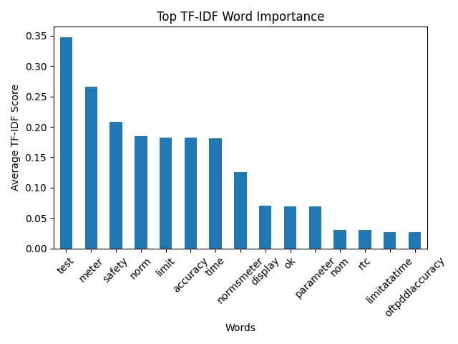
Results Obtained
[Step-3] TF-IDF Feature Engineering
Key Insights:
Generated 1048 unique textual features using TF-IDF vectorization
Each word assigned a numerical importance score based on its relevance
Successfully transformed unstructured text into meaningful numerical representation
Feature Importance Analysis (Graph Insight):
The graph shows Top TF-IDF weighted words influencing classification
Words like: “test”, “meter”, “safety” have highest importance
These words indicate core domain relevance in meter testing remarks
Observations:
High TF-IDF score words are frequent yet contextually important.
Domain-specific keywords are clearly identified.
Model can use these features to differentiate between departments/actions.
4/1/2026

Slide 12
Cancellation_Hold Reason Code
Access / Availability Issues
Code | Meaning
D030 | Meter not traceable / wrong address
D120 | Consumer not available
D315 | Wrong pole number / wrong address
D385 | No person at site / no phone response
D430 | Premises Locked
D440 | Premises Sealed
D500 | Site under construction
D560 | Visit not done
D610 | Consumer refused testing
Safety / Site Condition Issues
Code | Meaning
D271 | Unsafe site condition (damaged insulation, unsafe wiring)
D606 | Water logging at site
D603 | Space constraint / meter at excessive height
Meter / Seal / Technical Blocking Issues
Code | Meaning
D168 | Meter terminal / box seals broken (suspected case)
D275 | Meter box damaged
D320 | Meter terminal seal missing → Refer to CEG
D460 | Meter terminal & box seals missing → Refer to CEG
D601 | Insufficient load for testing
Electrical / Network Issues
Code | Meaning
D395 | Low voltage → Refer to Zone
D510 | Solar / phase voltage issue
D330 | Neutral not present from Supply End
D400 | Solar Panel not working
Administrative / System Issues
Code | Meaning
D270 | Meter already replaced
D360 | Meter retained as per system
D570 | Work already done on another service order
D580 | Wrong notification generated
Replacement / Defective Meter Cases
Code | Meaning
D255 | Mechanical/Class-2 meter → Replace
D490 | Display defect / RTC fail → Replace

